Slide 1
Capstone Project: Searching for coal Leah Pettigrew, Data Scientist
Notes:
Morning everyone,
Thanks for joining for my capstone project which I’ve titled “searching for coal”
My name’s Leah and one of my roles at the moment is a Data Scientist

Slide 2
Agenda
Bio
Project Context
Define
Design
Deliver
Summary, conclusions and next steps
Appendix: list of supporting documents
Notes:
I’ll just run through agenda,
I’ll give a quick bio about myself
Project context
Then through define, design deliver
And finally a summary, conclusion and next steps.
I have also added an appendix with some additional supporting documentation

Slide 3
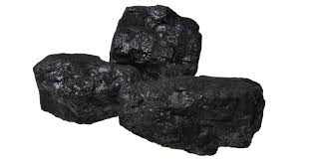
BIO

Slide 4
BIO
Chartered Accountant
Commercial and Financial Specialist
Use Excel A LOT
Working with large data sets
Data scientist skills extremely useful in my industry
This capstone project will continue to be worked on after the course is finished
Notes:
So a bit about myself:
My background is in transport and logistics, where I started working in the business unit operations.
During this I studied accounting and am now a Chartered Accountant
I am currently working as a commercial and financial specialist at a small consulting firm, where I’m about to go into partnership with the current director and another person
I am often working with large data sets and having the skills of a data scientist will be extremely useful in my industry

Slide 5
PROJECT CONTEXT

Slide 6
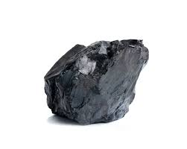
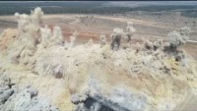
Business Context
What’s happening in the Industry, why do we want to solve this problem?
Industry: Mining, particularly drill & blast
Problem Area: An exploration process is trying to be used as part of BAU and it’s not cost or time effective
Metrics are recorded as part of BAU/Production drilling
If mining companies could accurately determine what type of rock is being drilled through while drilling as part of BAU work it would be a game changer in the industry
I previously worked at a logistics company focused on the mining
Industry for over 10 years and my husband is a mining engineer
Notes:
So for this particularly project, the industry we are looking at is mining
The problem here is that it’s expensive to do exploration drilling to determine where there is coal or not coal. An exploration process is trying to be used as part of BAU and this isn’t cost or time effective.
When drilling is done at mine site, there are a number of metrics that are recorded during the drill. If mining companies could use this information to determine what type of rock is being drilled through while drilling as part of BAU (which they already have to do anyway) it would be a game changer in the industry
My experience in this area is that the logistics company I worked at for over 10 years was predominantly focused in the mining industry, and my husband is a mining engineer
And just to capture everyones attention, I’ve popped in a little video showing how they blast for coal. It’s really important that the holes are drilled in the right spot, and the explosives put in to the correct depths to get the most coal. Getting this model correct to predict coal accurately (and just as importantly, not coal) would make a huge impact on the coal mining industry

Slide 7
DEFINE

Slide 8
Business Aspects
Stakeholders
Drill & Blast employees
Mine Planning Engineers
Shareholders
Business question
How can I get a high-resolution model of my geology quickly and accurately to determine if the rock being drilled through is coal or not, without relying on expensive exploration drilling that can weeks to get results?
Business value:
Improved optimisation of the mine planning
Avoidance of damaging coal
Achieving Contractual obligations
Model Evaluation
Notes:
The main stakeholders in this project are firstly the drill and blast employees, the mine planning engineers and also importantly, the shareholders.
The business question being asked is: How can I get a high-resolution model of my geology quickly and accurately to determine if the rock being drilled through is coal or not, without relying on expensive exploration drilling that can take weeks to get results?
By implementing this model, drill and blast costs wouldn’t decrease as we would still be utilising this part of the value chain as is, if not more. The benefit is that there is improved optimisation of the mine planning; which means there would be more revenue produced overall, and less demurrage costs incurred. Another benefit to adopting this model is to avoid damaging coal – if blast limits can be optimised to avoid coal damage then coal loss and dilution is limited which is one of the major reasons for mining companies not achieving their Contractual obligations

Slide 9
Data Science Aspects
Data question: Can I use the Measurements While Drilling (MWD) data to determine if the rock being drilled through is coal or not coal?
Data required: MWD data
Data sourced: Deidentified data from unknown mining company
How is the data generated? While drilling, data about the type of rock being drilled through is captured
How it can be sourced in the future? Working directly with coal mining companies to develop something that can benefit both parties
Model Evaluation
Notes:
The data question is can I use the Measurements While Drilling data to determine if the rock being drilled through is coal or not coal? The data I’ve used in this project has been deidentified, however in the future I hope to work directly with a coal mining company to develop something that can benefit both parties. The data is generated in real time, while the drill is happening.

Slide 10
DESIGN

Slide 11
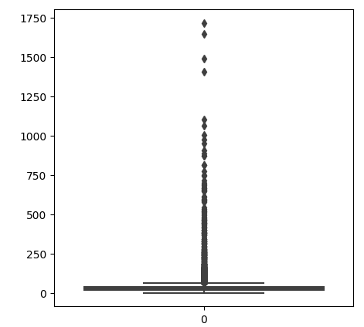
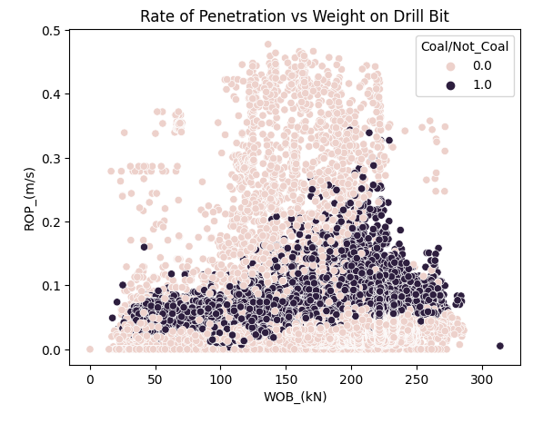
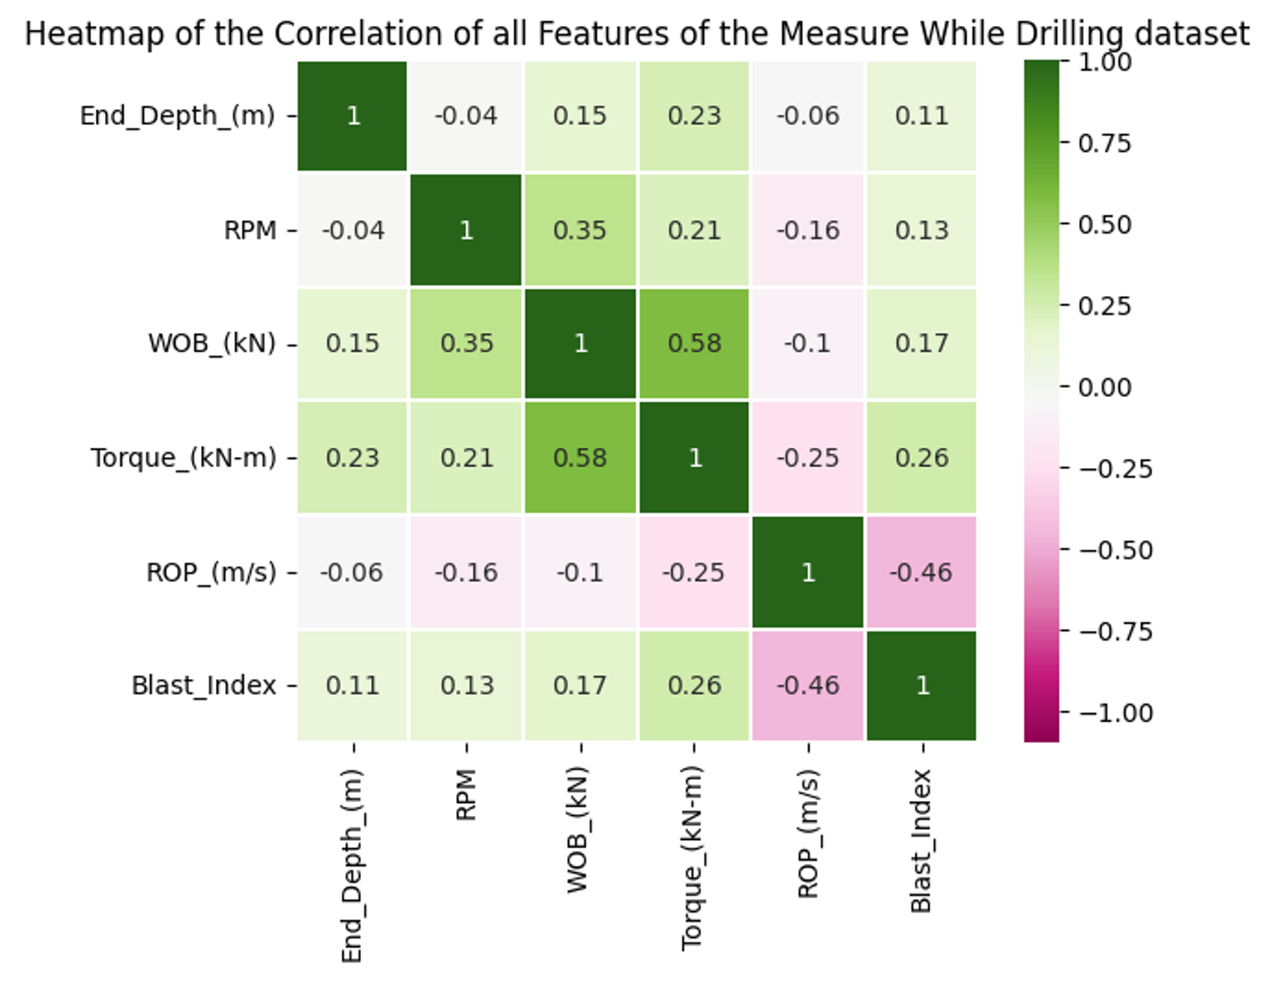
Data exploration, analysis and visualisation
Data was skewed differently for each feature, some left, some right, some normal
Outliers resulted in feature being removed
Scatter Plot after outliers removed – coal is the dark area in the middle
Heatmap shows highest correlation between Torque & WOB at 0.58
Classification Models most appropriate
Notes:
So my data was skewed differently for each feature with some left, some right and some normally distributed. The boxplot on the left shows that there were significant outliers in one of the fields which turned out to be a calculated field that was calculated incorrectly, this feature was removed from the model
Once this was removed I was able to generate this scatter plot where you can see the coal as the dark dots through that area in the middle there. This plot is using the features rate of penetration of the drill bit, and the weight on the drill bit. Coal is generally a softer rock than most other rocks
I also did a heatmap to view the correlation between the remaining features, and the highest correlation was between Torque & WOB, however as it’s only 0.58 it didn’t affect decisions around which features to use in the model

Slide 12
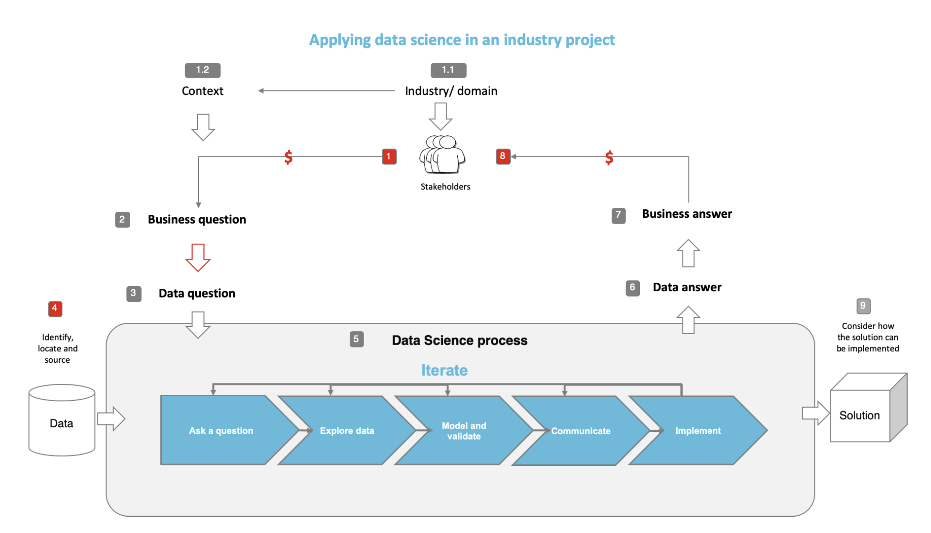
Overall Process Flow Used
Capstone Project – Coal
Notes:
Here is the process flow that was in the sample preso we were given. I was going to put my own spin on it but it’s relevant and straight forward, and I used all my creativity making a value chain map of coal mining for my report

Slide 13
DELIVER

Slide 14

Feature Engineering & Overall Solution
Feature engineering:
Forward Feature Selection = 4 Features
# of Rocks – reduced from 5 to 2
# of Features overall – reduced from 11 to 6
Overall Solution:
How does the model fit in the overall solution?
Real time models of the geology in the area being drilled
Who will use it?
Drill and blast engineers
When is it used?
Every time they drill for blasting
How does it benefit the business?
Cost Savings, Environment Impact
Notes:
In terms of feature engineering, I touched on before how I removed the derived field completely from the data set. After this I then did forward feature selection which resulted in me using 4 of the most important features in my modelling. These particular features were Weight on the drill bit, the Torque, RPM, and ROP – these all have slightly different metrics depending on the type of rock the drill is passing through.
There were no null values, and at the beginning there were 5 rock types which I reduced to just 2 being coal or not coal for the purpose of these models. After feature engineering was complete the number of features overall reduced from 11 down to 6.
I am looking to create a model here that will fit the overall solution of being able to determine in real time what the geology is of the area currently being drilled.
In my mind, the drill and blast engineers will be able to upload the drilling data in real time and have the model tell them as accurately as possible what type of rock they are drilling through. It can be used during every drill when they are blasting, of if they prefer to save the cost they can pick and choose at what points they think it is most necessary. This benefits the business with significant cost savings by supplementing exploration drilling data with BAU production data in real time. There is also the benefit of less environmental impact and unnecessary blasting and core drilling.

Slide 15
Machine models used and their evaluation metrics
Mini Project 3 - Logistic Regression, Naïve Bayes, SVM
Logistic Regression Model with Outliers
Stacking
Decision Tree
Neural Network
Recall = 0.57
Recall = 0.57
Recall = 0.88
Recall = 0.92
Loss = 5.8
Notes:
In mini project 3 I did multiple models of logistic regression, naïve bayes and Support Vector Machine with all sorts of different hyperparametrers . During this it became obvious that the evaluation metrics were all very similar and quite accurate for coal however there were consistently too many false negatives which meant that I focused my capstone on specifically improving the recall metric. In mini project 3 the SVM was the most accurate but took too long to run, the logistic regression was next best but the recall was only 0.57 so needed significant improvement. The results of these are all in the Appendix.
I did a logistic regression model including outliers which didn’t improve the recall at all. I did a stacking model which improved the recall to 0.88. I followed this with a decision tree which gave a recall of 0.92 while all other metrics were still above 0.9 and also performed better than any previous models with an overall accuracy of 0.97.
Lastly I did a neural network which I struggled with a bit and ended up doing multiple iterations. Initially the model was not learning but I ended up putting it in batches, changed the optimiser, added in regulisers, and in the end came up with a loss score of 5.8. There is still a lot more I would like to do on tweaking these models, the neural network in particular.

Slide 16
SUMMARY, CONCLUSION AND NEXT STEPS

Slide 17
Summary, conclusions and next steps
Summary
A brief recap of the presentation
Conclusions
What has been achieved?
Next steps
Notes:
So just to summarise everything we’ve just looked at.
I would like to develop a model that can predict what type of rock a drill is drilling through during production drilling at a coal mine
We went over the initial data exploration and feature engineering, and then onto the different models that I ran
In the end the decision tree and neural networks look to be the best models, and further consultation with mining companies needs to be done to determine if the recall rates are acceptable in the industry.
Next steps are to start discussions with a mining company, and to further tweak the neural network model to try and improve the results.

Slide 18

QUESTIONS (AND SUGGESTIONS)?

Slide 19
APPENDICES

Slide 20
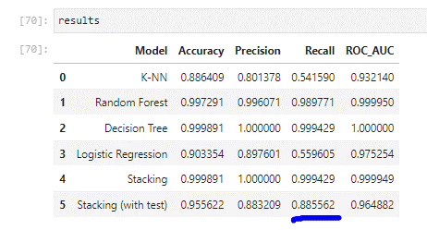
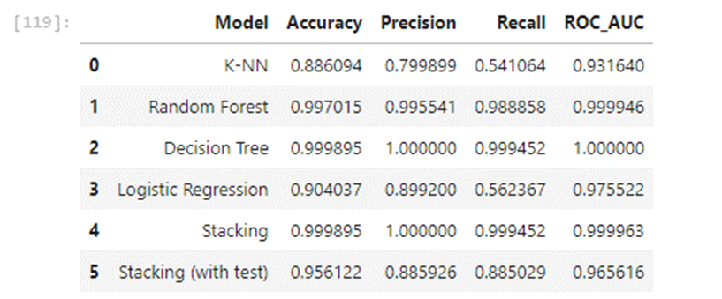
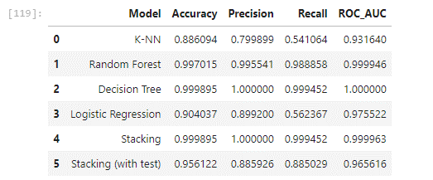
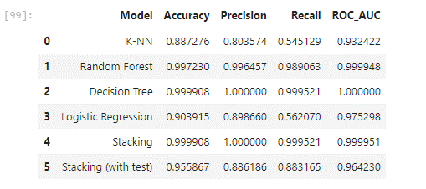
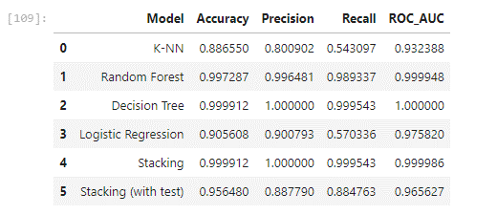
Appendix 1: Stacking Model run 5 times

Slide 21

APPENDIX 2: MINI PROJECT 3 RESULTS

Slide 22
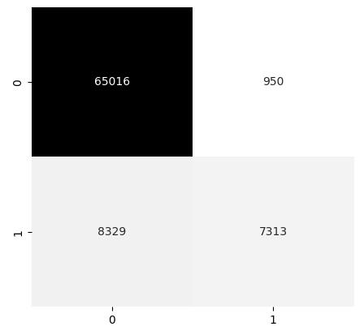
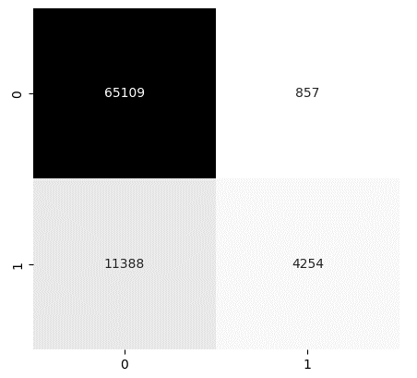
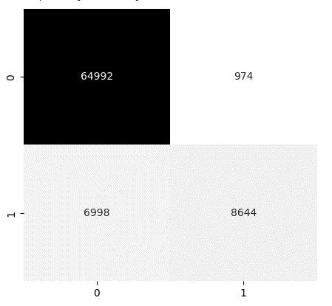
Mini Project 3 - Model 1 – Logistic Regression
FEATURE SELECTION
LR Model 1
LR Model 2
LR Model 3
Features
1. WoB (kn)
2. RoP (m/s)
3. RPM
Features
1. WoB (kn)
2. RoP (m/s)
3. RPM
4. Torque
Features
1. WoB (kn)
2. RoP (m/s)
Accuracy 88.6%
Accuracy 84.9%
Accuracy 90.2%
Mini Project 3 – Coal
Notes:
The first model I ran is logsitc regression. I ran this with 2, 3 and 4 features – running with 4 features was the most accurate at 90.2%
The accuracy metric computes how many times a model made a correct prediction across the entire dataset
The green circles show the best result for each metric of the confusion matrix
There are far less false negatives on the third one, and the least false positives are on the middle one.
What would you pick as the best model here??

Slide 23
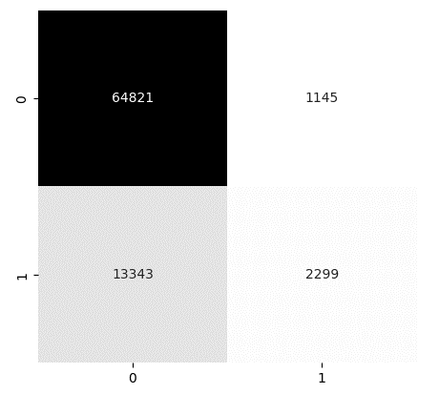
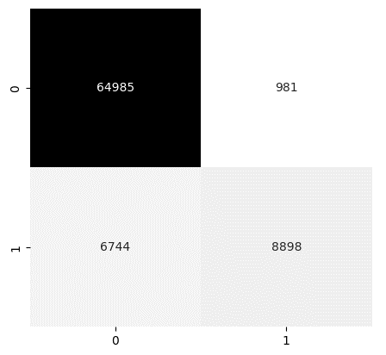
Mini Project 3 - Model 1 – Logistic Regression
Features
1. WoB (kn)
2. RoP (m/s)
3. RPM
4. Torque
HYPERPARAMETER TUNING
LR Model 3
sag
LR Model 3
Newton-cg & lpfgs
LR Model 3
liblinear
Accuracy 82%
Accuracy 90.5%
Accuracy 90.2%
Mini Project 3 – Coal
Notes:
I then chose the third model which was the most accurate and applied a few hyperparameters.
What would you choose as the best model here?
Using the newton-cg hyperparameter I was able to get the accuracy up to 90.5%

Slide 24
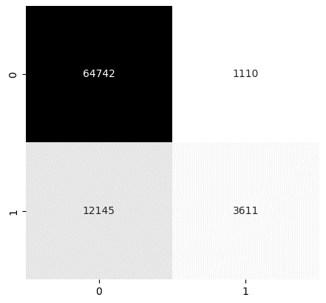

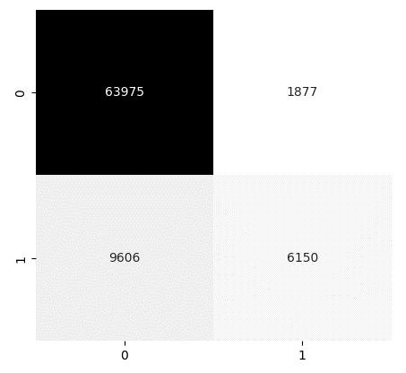
Mini Project 3 - Model 2 – Naïve Bayes
FEATURE SELECTION
NB Model 1
NB Model 2
NB Model 3
Features
1. WoB (kn)
2. RoP (m/s)
3. RPM
Features
1. WoB (kn)
2. RoP (m/s)
3. RPM
4. Torque
Features
1. WoB (kn)
2. RoP (m/s)
Accuracy 83.7%
Accuracy 83.8%
Accuracy 85.9%
Mini Project 3 – Coal
Notes:
For the second model I chose to use Naïve Bayes.
Unfortunately the accuracy on this one regardless on the number of features used was always below 90%.
The best false negative rate was 9,606 which is way too high. I didn’t run this model any further
What would you pick?

Slide 25
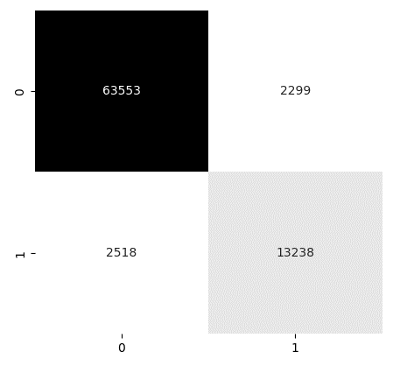
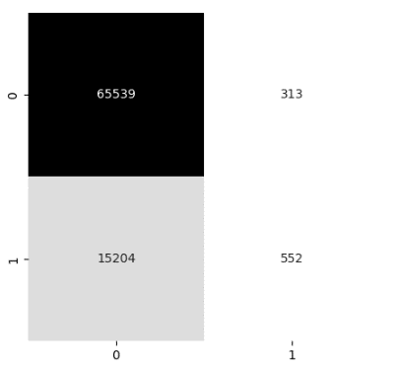
Mini Project 3 - Model 3 – Support Vector Machine
FEATURE SELECTION
SVM Model 1
SVM Model 2
SVM Model 3
Features
1. WoB (kn)
2. RoP (m/s)
3. RPM
Features
1. WoB (kn)
2. RoP (m/s)
3. RPM
4. Torque
Features
1. WoB (kn)
2. RoP (m/s)
NOT UPDATED
Accuracy 94.1%
Accuracy 80.9%
Accuracy TBA
Mini Project 3 – Coal
Notes:
The last model I ran was the Support Vector Machine
Ran with just the 2 features the accuracy was higher than any previous model
Importantly, the false negatives are far lower than any of the previous models run as well.
I then ran this with 3 features and surprisingly the accuracy dropped significantly, particularly the false negatives, and it also took 2 days to run
I plan to run this with 4 features and do some hyperparameter tuning in my capstone project to see if I can get the accuracy even higher than 94%

Slide 26

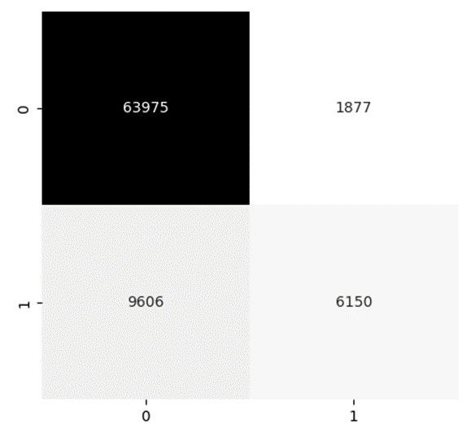
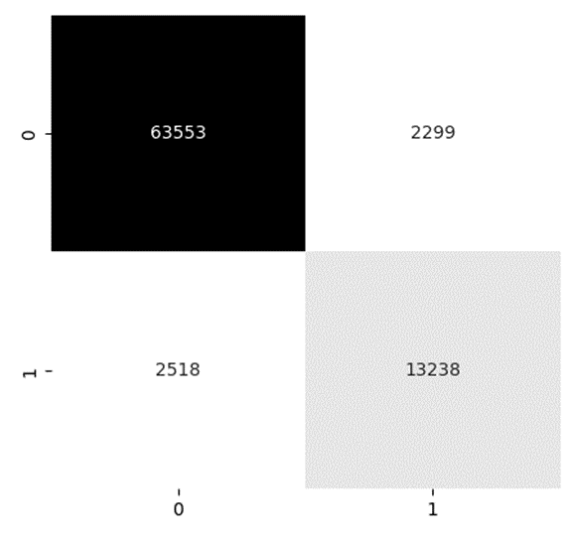
Mini Project 3 - Initial Model Selection & Evaluation
The following 3 were the most accurate of each of the models run
Model | Coal or Not Coal? | Precision | Recall | F1-score | Accuracy | # of Features
Logistic Regression (model 3, newton-cg) | 0 = Not Coal | 0.91 | 0.99 | 0.94 | 0.91 | 4
 | 1 = Coal | 0.90 | 0.57 | 0.70
Naïve Bayes | 0 = Not Coal | 0.87 | 0.97 | 0.92 | 0.86 | 4
 | 1 = Coal | 0.77 | 0.39 | 0.52
Support Vector Machine | 0 = Not Coal | 0.96 | 0.97 | 0.96 | 0.94 | 2
 | 1 = Coal | 0.85 | 0.84 | 0.85
Logistic Regression
Naïve Bayes
Support Vector Machine
Mini Project 3 – Coal
Notes:
The best performing from each of the 3 models is summarised here. After running all 3 models with different features and hyperparameter tuning, it’s fairly clear that the most accurate result is the SVM. The Logistic Regression and Naïve Bayes was most accurate with 4 features, and SVM with only 2 features was more accurate than the best of these other models. It took an entire day to run the model with the 3 features so I am hoping to get the 4 features run to present in my capstone presentation.
All of the models are quite accurate at predicting coal, however there are way too many false negatives in the logistic regression model and naïve bayes models (as seen in the recall scores highlighted above )
This would cost the company considerable money as they would be ruining good coal thinking it was a different type of rock.
Due to this the ROC curve isn’t the best way to look at this data, the confusion matrix is as it gives a good balance of the impact of both false negatives and false positives.
When the objective is to minimise false negatives, the recall metric is often used to evaluate the model, you can see above I have included the precision, recall and the f1 score which combines the precision and recall scores of a model. Finally I’ve also added in the accuracy as per the previous slides
However if you’re interested in seeing the ROC curves or the other metrics like the coefficient, intercept, sensitivity etc they are all in my Jupyter notebook which I’m happy to share

